Slide 1

Miscellaneous Classes and Tools
Kristine Middlemiss, Developer Consultant
Autodesk Developer Network (ADN)

Slide 2
Agenda
DG / DAG Operations
Maya Callback System
Software Shader
Custom Translator

Slide 3

DG/ DAG Operations

Slide 4
DG/DAG Operations
MDGModifier / MDagModifier
Facilitate the creation or deletion of nodes and connections
Provides undo/redo support
MDagModifier: dag node creation/parenting
Holds a list of operations. Operations are queued as they are called.
Does not perform these operations until MDGModifier::doIt() call is issued.

Slide 5
MDGModifier code structure
All these operations won’t get executed until dgMod.doIt()
To undo all these operations, dgMod.undoIt()
MDGModifier dgMod;
dgMod.createNode ( “transform”);
dgMod.commandToExecute(“sphere -n sphere1 -r 1;”);
dgMod.connect(.....);
.....
dgMod.doIt();

Slide 6
Example: setUpTransCircle
transCircle node
setUpTransCircle: In this example, we create a custom command, and simulate the same functionality of the MEL operations we used in “transCircleNode” project, which set up the transCircle node.
Here are the commands you need to simluate:
createNode transCircle -n circleNode1;
sphere -n sphere1 -r 1;
sphere -n sphere2 -r 2;
connectAttr sphere2.translate circleNode1.inputTranslate;
connectAttr circleNode1.outputTranslate sphere1.translate;
connectAttr time1.outTime circleNode1.input;

Slide 7
Maya Callback System
Maya callbacks allow the user to register functions against specific Maya events.
Maya callback classes:
MMessage: base class, remove callback, query callbacks
MDGMessage - node added, removed, connected
MNodeMessage - attribute callbacks
MSceneMessage - before/after: file open, import, export, etc.
MUiMessage - UI objects
MEventMessage - idle, timeChanged, undo, redo, etc.
MConditionMessage - specific conditions
MModelMessage - model related messages

Slide 8
MMessage and Callback Functions
MSceneMessage::addCallback ( MSceneMessage::Message msg,
, void * clientData = NULL, MStatus * ReturnStatus = NULL )
typedef void(* MMessage::MBasicFunction )(void *clientData)
MMessage::MBasicFunction func
MSceneMessage::kAfterOpen
MSceneMessage::addCallback( MSceneMessage::kAfterOpen, &afterFileOpenCallback);

Slide 9
MMessage and Callback Functions
MSceneMessage::addCallback ( MSceneMessage::Message msg,MMessage::MBasicFunction func, void * clientData = NULL, MStatus * ReturnStatus = NULL )
static MCallbackId id;
void afterFileOpenCallback(void* clientData)
{
cout << “Come to this afterFileOpenCallback function\n”;
}
void MyCmd::addCallback()
{
MSceneMessage::addCallback( MSceneMessage::kAfterOpen, &afterFileOpenCallback);
}
id =
void MyCmd::removeCallback()
{
MMessage::removeCallback( id );
}

Slide 10
Abort operations
MCallbackId MSceneMessage::addCheckCallback ( MSceneMessage::Message msg, MMessage::MCheckFunction func, void * clientData = NULL, MStatus * ReturnStatus = NULL )
retCode: Result of the function. Provide programmer with options to abort current operations by return false through this variable.
MSceneMessage::kBeforeOpenCheck
typedef void(* MMessage::MCheckFunction)(bool *retCode, void *clientData)

Slide 11
Abort Operations
void beforeOpenCheckCallback(bool* retCode, void* clientData)
{
//Do custom operations, for example, check file versions...
cout << “Error: file version is not correct, abort opening operations\n”;
* retCode = false;
}
void MyCmd::addCallback()
{
MSceneMessage::addCheckCallback(MSceneMessage::kBeforeOpenCheck, &beforeOpenCheckCallback);
}

Slide 12
Example: sceneMsgCmd
sceneMsgCmd: this example register several callbacks for scene messages such as MSceneMessage::kBeforeOpen and MSceneMessage::kAfterNew, it also shows how to abort the operation by setting retCode.

Slide 13
Shading Network and Software Shader
Different types of software shaders
Shading group
Custom Software Shader

Slide 14
Software Shading Node
DG Nodes to form Shading Networks
Different Types of Software Shading Nodes:
Type | Frame
Textures | 2D Textures, 3D Textures Environment Textures
Materials | Surface Materials, Volumetric Materials Displacement Materials
Lights | Lights
Utilities | General Utilities Color Utilities Particle Utilities Image Planes Glow

Slide 15
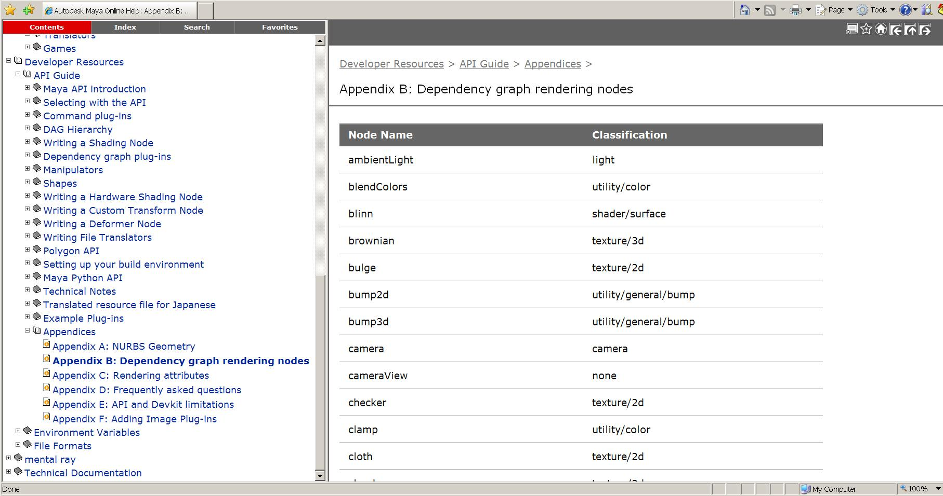
Shading Nodes List
Developer Resources -- API Guide -- Appendices – Appendix B: Dependency Graph rendering Nodes

Slide 16
Shading Group
An Object Set
A logical grouping of an arbitrary collection of objects, attributes or component of objects
Membership is defined by connections:
whole object is in set:
node.instObjGroups → objectSet.dagSetMembers
A part of components are in set:
node.objectGroups → objectSet.dagSetMembers
MEL command for “objectSet” node
sets -e -add blinn1SG pCubeShape2;
sets –q -size blinn1SG;

Slide 17
Shading Group (Renderable Sets)
Only renderable elements can be added into Shading Group
sets –q –renderable blinn1SG; //always return true
Every shader has to be connected with a shading group
Connection point between geometry and shader
shadingNode -asShader blinn;
// Result: blinn1 //
sets -renderable true -noSurfaceShader true -empty -name blinn1SG;
// Result: blinn1SG //
connectAttr -f blinn1.outColor blinn1SG.surfaceShader;
// Result: Connected blinn1.outColor to blinn1SG.surfaceShader. //

Slide 18
Rendering Network
Pre-computed Input attribute
renderer
Shader
Output attribute requested by shading group
Shading Group
geometry
Geometry information

Slide 19
Custom Shading Node
Registration:
MFnPlugin::registerNode ( const MString & typeName, const MTypeId & typeId, MCreatorFunction creatorFunction, MInitializeFunction initFunction, MPxNode::Type type = MPxNode::kDependNode, )
const MString * classification
Type | Frame | Classification String
Textures | 2D Textures, 3D Textures Environment Textures | “texture/2d” “texture/3d” “texture/environment”
Materials | Surface Materials, Volumetric Materials Displacement Materials | “shader/surface” “shader/volume” “shader/displacement”
Lights | Lights | “light”
Utilities | General Utilities Color Utilities Particle Utilities Image Planes Glow | “utility/general” “utility/color” “utility/particle” “imageplane” “postprocess/opticalFX”

Slide 20
Custom Shading Node
Code Structure:
class myShader : public MPxNode
{
public:
myShader();
virtual ~ myShader ();
virtual MStatus compute( const MPlug&, MDataBlock& );
static void * creator();
static MStatus initialize();
static MTypeId id;
private:
// Input attributes
…….
// Output attributes
…….
};

Slide 21
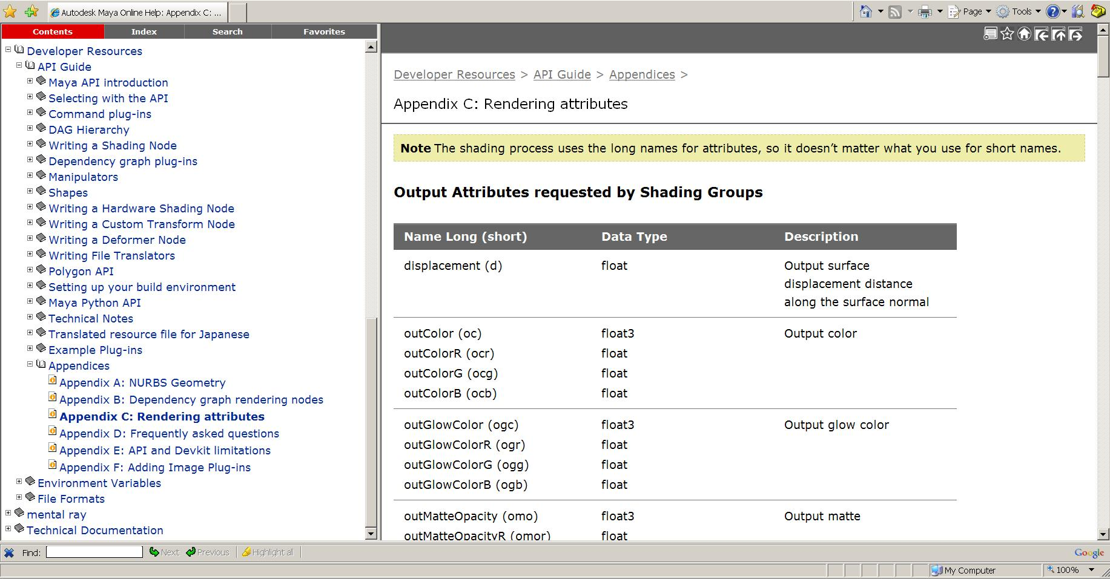
Software Shading Node
Rendering Attributes

Slide 22
Shading node icons for Hypershade
XPM format: 32x32
Icon name: preface "render_".
lambertShader.mll: render_lambertShader.xpm
XBMLANGPATH: Put the icons in one of the directories specified in your XBMLANGPATH.

Slide 23
Custom Translator
Transmitting data in your production pipeline
Define custom file format
Decide what contents you want to export
Plug-in vs. Standalone Application

Slide 24
Custom Translator Plug-in
Derived from MPxFileTranslator :
Maya consistent UI (File->Export, File->Import)
register your extension with Maya
implement a reader and writer in the same plug-in
Register MSceneMessage callbacks to execute operations before/after import/export
MSceneMessage::kBeforeExport
MSceneMesage::kAfterExport
MSceneMessage::kBeforeImport
MSceneMessage::kAfterImport

Slide 25
Devkit Example: lepTranslator
Adds the new file format “Lep” to the file manipulation dialogs
An “Lep” file is an ASCII file with a first line of “<LEP>”. The remainder of the file contains MEL commands that create one of the primitives: nurbsSphere, nurbsCone and nurbsCylinder, as well as move commands to position them.

Slide 26
MPxFileTranslator
Custom file format:
static MString myfileExt(“lep”);
MString MPxFileTranslator::defaultExtension()
return custom file format
MPxFileTranslator::identifyFile()
determine whether it is the type supported by the translator

Slide 27
MPxFileTranslator: read & write
MPxFileTranslator::canBeOpened()
decide whether it is an importer or exporter
bool MPxFileTranslator::haveReadMethod()
MStatus MPxFileTranslator::reader ( const MFileObject & file, const MString & optionsString, MPxFileTranslator::FileAccessMode mode )
Mode: the method used to read the file – open or import
bool MPxFileTranslator::haveWriteMethod()
MStatus MPxFileTranslator::writer ( const MFileObject & file, const MString & optionsString, MPxFileTranslator::FileAccessMode mode )
Mode: the method used to write the file - save, export, or export active

Slide 28
Example: lepTranslator
class LepTranslator : public MPxFileTranslator {
public:
LepTranslator () {};
virtual ~LepTranslator () {};
static void* creator();
MStatus reader ( const MFileObject& file,const MString& optionsString, MPxFileTranslator::FileAccessMode mode);
MStatus writer ( const MFileObject& file, const MString& optionsString,
MPxFileTranslator::FileAccessMode mode);
bool haveReadMethod () const;
bool haveWriteMethod () const;
MString defaultExtension () const;
bool canBeOpened() const;
MFileKind identifyFile ( const MFileObject& fileName,const char* buffer, short size) const;
private:
void getPosition( MObject& transform, double& tx, double& ty, double& tz );
static MString magic;
};

Slide 29
MPxFileTranslator
Register custom file translator:
MStatus initializePlugin( MObject obj )
{
MFnPlugin plugin( obj, PLUGIN_COMPANY, "3.0", "Any");
MStatus status = plugin.registerFileTranslator( "Lep", "lepTranslator.rgb", LepTranslator::creator,
"lepTranslatorOpts", "showPositions=1", true );
return status;
}

Slide 30
UI for MPxFileTranslator
Export Options: a text string with format:
varName1=value1;varName2=value2;...
In lepTranslator example, the option string is “showPositions = 1” or “showPositions = 0”
lepTranslatorOpts.mel
global proc int lepTranslatorOpts ( )
{
……
}

Slide 31
Q & A

Slide 32
Autodesk

